Slide 1
Waterkers AI
Project Experience

Slide 2
Inhoud
Opdracht
Dataset
Training
Testen/evalueren
Deployment
Dashboard
Conclusie

Slide 3
Opdracht

Slide 4
Dataset

Slide 5

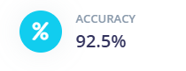
Training
Project Preparation
Impulse Design
Model Training and Validation
Model Optimization
Testing and Evaluation
Device Integration
Deployment Options
Scalability and Application

Slide 6
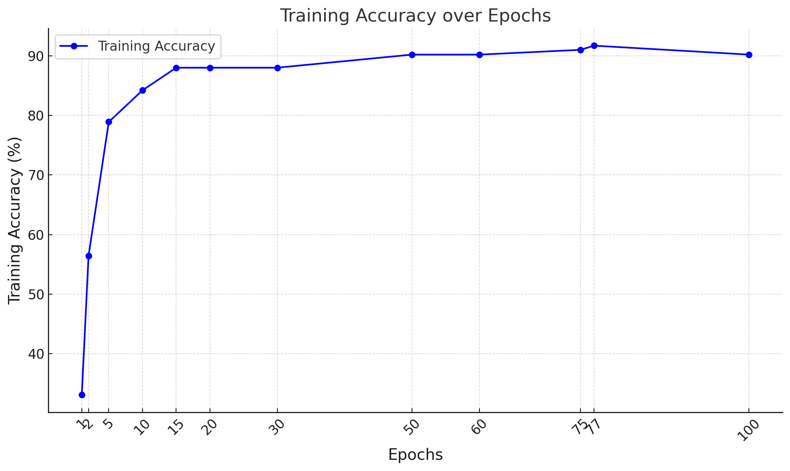
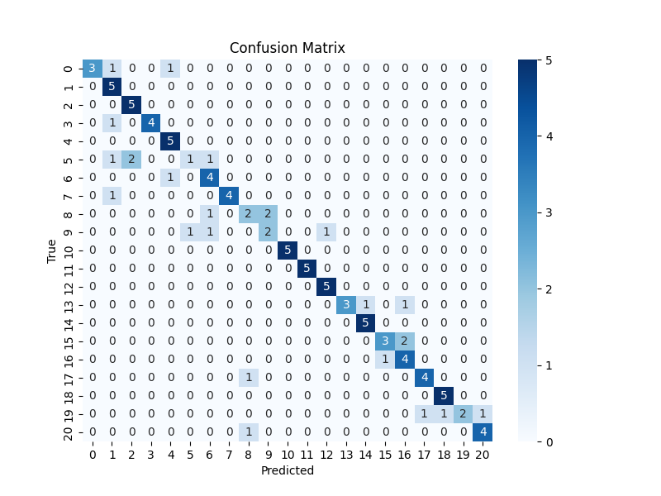
Testen/evalueren

Slide 7
Deployment

Slide 8
Dashboard

Slide 9
Conclusie

